Slide 1
Kaggle Cardiac Data DSC 530 DATA EXPLORATION AND ANALYSIS Sam Loyd November 2019
Notes:
Normally in data science presentations, it is important to understand your audience. In that goal, I have elected to assume the instructor and the DSC 530 class are that audience so this content is presented at a more technical level.

Slide 2
KAGGLE Cardiac Data code Book PROVIDED BY SVETLANA UNLIANOVA at RYERSON UNIVERSITY https://www.kaggle.com/sulianova/eda-cardiovascular-data/notebook#EDA-of-cadiovascular-diseases-data
Numerical Data
Binary Data
CATEGORICAL DATA
AGE - days
HEIGHT - cm
WEIGHT - kg
SYSTOLIC BLOOD PRESSURE
DIASTOLIC BLOOD PRESSURE
GENDER
SMOKING
ALCOHOL
PHYSICAL ACTIVITY
CARDIOVASCULAR DISEASE
CHOLESTEROL
GLUCOSE
Notes:
Codebook taken from Ulinva’s notebook:
Age | Objective Feature | age | int (days)
Height | Objective Feature | height | int (cm)
Weight | Objective Feature | weight | float (kg)
Gender | Objective Feature | gender | categorical code
Systolic blood pressure | Examination Feature | ap_hi | int
Diastolic blood pressure | Examination Feature | ap_lo | int
Cholesterol | Examination Feature | cholesterol | 1: normal 2: above 3: well above
Glucose | Examination Feature | gluc | 1: normal, 2: above 3: well above
Smoking | Subjective Feature | smoke | binary
Alcohol intake | Subjective Feature | alco | binary
Physical activity | Subjective Feature | active | binary
Presence or absence of cardiovascular disease | Target Variable | cardio | binary (Ulinova, n.d., para. 5)
Reference:
Ulinova, S. (n.d.). EDA of cadiovascular diseases data. Retrieved from https://www.kaggle.com/sulianova/eda-cardiovascular-data/notebook#EDA-of-cadiovascular-diseases-data

Slide 3
HYPOTHESIS Does being overweight as measured by the standard BMI formula using weight and height, tend to increase the likelihood of having a cardiovascular disease?
How does gender impact the answer to the question above if at all?

Slide 4
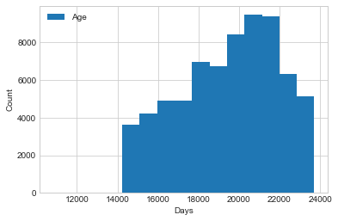
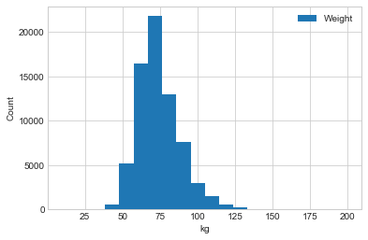
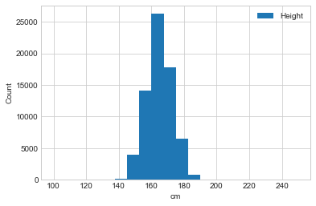
EXAMPLES FROM DISTRIBUTION ANALYSIS
AGE
WEIGHT
HEIGHT
Statistics indicate symmetry and
platykurtic (light tailed).
Statistics show positive skew and
leptokurtic (heavy tailed).
Statistics indicate negative skew and leptokurtic.
Notes:
AGE:
Mean: 19468.865814285713
Median: 19703.0
Skew: -0.3070553957245462
Kurtosis: -0.8234468444820653
Variance: 6087330.789505426
Std Dev: 2467.2516672413913
WEIGHT:
Mean: 74.20569
Median: 72.0
Skew: 1.0120701082089065
Kurtosis: 2.5868254500056223
Variance: 207.2378103468814
Std Dev: 14.39575667851056
HEIGHT:
Mean: 164.36358049394008
Median: 165.0
Skew: -0.6394827943261461
Kurtosis: 7.9622969785301985
Variance: 67.28028750431609
Std Dev: 8.202456187284154

Slide 5
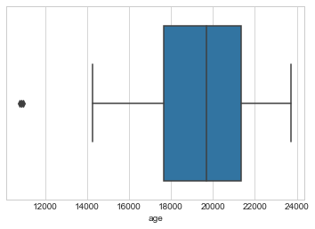
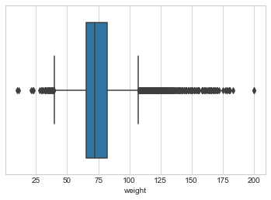
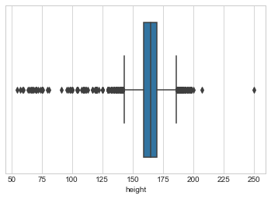
EXAMPLES FROM OUTLIER ANALYSIS
AGE
WEIGHT
HEIGHT
Age 29 was reasonable so not removed.
Removed cases over 181 kg and less than 36 kg.
Removed top outlier to the right and all less than 121 cm or 4 ft.
Notes:
Other outliers were also found on blood pressure values.
Systolic observations were removed if less than 71 and greater than 199.
Diastolic observations were removed if less than 41 and greater than 139.
Observations with diastolic values higher than systolic values were also removed.
The following are direct quotes from two articles:
A hypertensive (high blood pressure) crisis is when blood pressure rises quickly and severely with readings of 180/120 or greater (AHA, n.d., para 1).
Some experts define low blood pressure as readings lower than 90 mm Hg systolic or 60 mm Hg diastolic. If either number is below that, your pressure is lower than normal (Mayo Clinic, n.d., para 17).
Reference:
AHA, (n.d.). Hypertensive Crisis: When You Should Call 9-1-1 for High Blood Pressure. Retrieved from https://www.heart.org/en/health-topics/high-blood-pressure/understanding-blood-pressure-readings/hypertensive-crisis-when-you-should-call-911-for-high-blood-pressure
Mayo Clinic, (n.d.). Low blood pressure (hypotension). Retrieved from https://www.mayoclinic.org/diseases-conditions/low-blood-pressure/symptoms-causes/syc-20355465

Slide 6
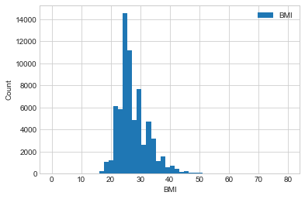
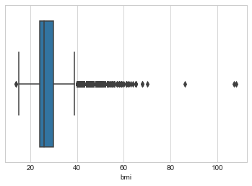
CALCULATED BMI
The formula for BMI is weight in kilograms divided by height in meters squared. Using this data set that is weight divided by the square of the height after it is divided by 100.
INITIAL HISTOGRAM
Box PLOT - OUTLIERS
FINAL HISTOGRAM
Positive skew and leptokurtotic.
Removed extreme cases based on domain knowledge.
Slight kurtosis improvement which was hard to detect visually.
Notes:
BMI < 18.5 underweight 18.5 - 25 normal 25.0 - 30 overweight > 30 obese
OBESITY: Class 1: 30 to < 35 Class 2: 35 to < 40 Class 3: 40 or higher (CDC, n.d.)
Reference:
CDC, (n.d.). Defining Adult Overweight and Obesity. Retrieved from https://www.cdc.gov/obesity/adult/defining.html
Removed BMIs higher than 99 and less than 16.

Slide 7
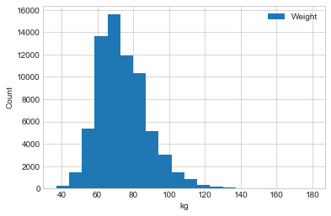
FOLLOW UP ANALYSIS POST OUTLIER REMOVAL
AGE
WEIGHT
HEIGHT
No changes to outlier or analysis.
Lessened kurtosis.
Most improved example with relatively normal statistics.
Notes:
AGE:
Unchanged.
WEIGHT:
Mean: 74.21658258060829
Median: 72.0
Skew: 1.00217356575386
Kurtosis: 2.3654336155679774
Variance: 205.7578274094943
Std Dev: 14.344261131529024
HEIGHT:
Mean: 164.43941215191322
Median: 165.0
Skew: 0.10908161496923831
Kurtosis: 0.22083446951193153
Variance: 61.790128519216665
Std Dev: 7.860669724598322

Slide 8
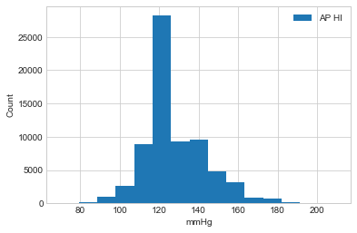
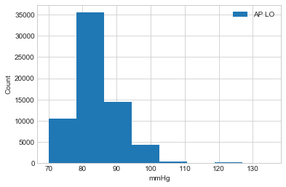
CONTINUED ANALYSIS POST OUTLIER REMOVAL
SYSTOLIC
DIASTOLIC
BMI
Slight positive skew and leptokurtic.
Relatively normal skew and leptokurtic.
Positive skew and leptokurtic.
Notes:
SYSTOLIC OR AP_HI:
Mean: 126.82905552276621
Median: 120.0
Skew: 0.7598588736081258
Kurtosis: 0.9333338734723617
Variance: 276.4307004050727
Std Dev: 16.626205231653813
DIASTOLIC OR AP_LO:
Mean: 81.24775551981284
Median: 80.0
Skew: 0.2311814630183121
Kurtosis: 1.073681791065506
Variance: 85.98374052081441
Std Dev: 9.272741801690286
BMI:
Mean: 27.43202562752326
Median: 26.0
Skew: 1.215403478838704
Kurtosis: 2.7866235498032927
Variance: 26.95222741966617
Std Dev: 5.191553468824738

Slide 9
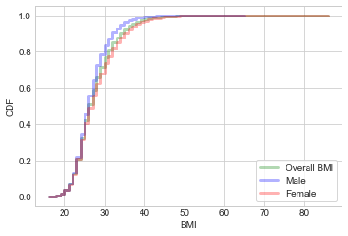
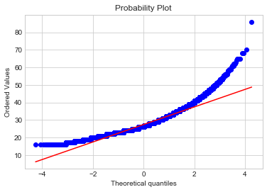
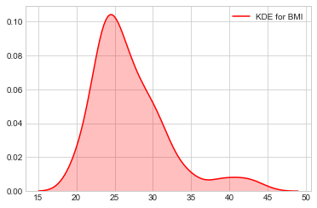
FURTHER EVIDENCE OF NON GAUSSIAN DISTRIBUTION for BMI
CDF
PROBABILITY PLOT
KDE
Plot indicates skew.
Note the deviations from the line.
Non-symmetrical indicating skew.
Notes:
The cumulative distribution plot function indicates skew.
Note the deviation from the line on both ends of the probability plot which deviation from a normal model.
The kernel density estimate is not symmetrical. This is further evidence of skew.
This evidence combined with the previous slides strongly back up my decision to use Spearman’s method over Pearson’s for correlation analysis.

Slide 10
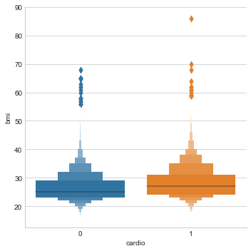
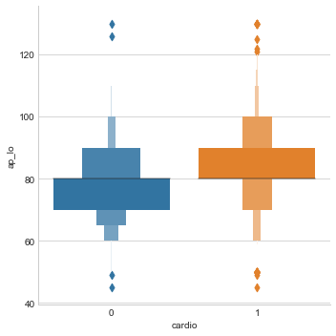
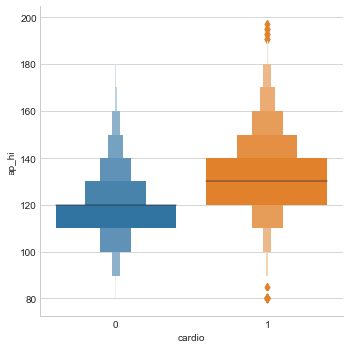
CARDIO Visualizations using BOXEN PLOTS
Due to the binary nature of having a cardio disease used in this analysis, enhanced box plots from the python based seaborn package were utilized for visualizations.
BMI - CARDIO
DIASTOLIC - CARDIO
SYSTOLIC - CARDIO
Correlation appears slightly noticeable.
Indicates some positive correlation.
Strongest visual of positive correlation.
Notes:
Boxen or enhanced box plots are created by the boxen function in the Seaborn package in python.

Slide 11
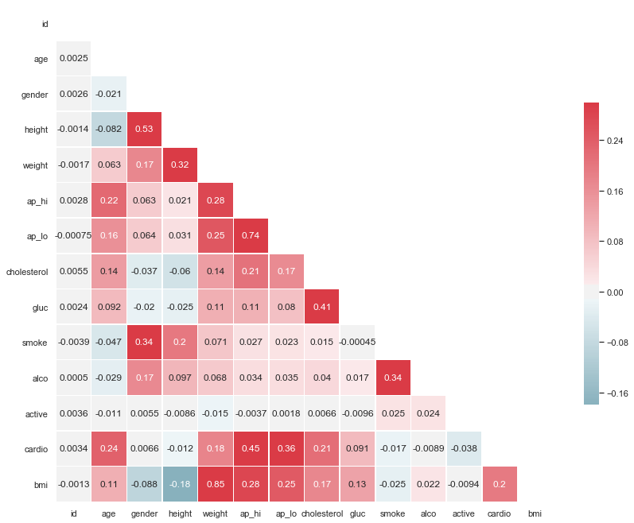
Correlation Heatmap Using Spearman’s Method
Notes:
As the graph shows, systolic (ap_hi) and diastolic (ap_lo) pressure had the highest correlation. This was followed by age, cholesterol, bmi and then weight respectively.

Slide 12
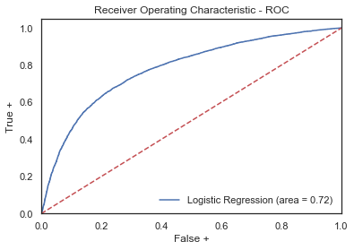
ROC Curve from Sklearn’s LogisticRegression Function
Notes:
This model was built using age, gender, height, weight, ap_hi, ap_lo, cholesterol, gluc, smoke, alco, active, cardio, bmi, obese letting the LogisticRegression function do the work. The other model that I found had the same accuracy using only model = smf.logit('cardio ~ bmi + ap_hi + age + C(gender)', data=dfcardio).
I have concerns about overfit of these models. Using ap_hi alone as simple regression was very close and less risk of overfit.

Slide 13
Conclusion CORRELATION BETWEEN BMI and cardiovascular disease, while statistically significant, was weak. SYSTOLIC Blood pressure had A stronger correlation AND WAS more useful in constructing predictive models.
Gender as confirmed by multiple tests did not prove to have a correlation with heart disease in this population. Given the unknown amount of sampling and other bias in this population set, I would discourage projecting this conclusion onto a larger population set such as the general public.
Notes:
Even though blood pressure measures proved more useful, the regression models had around a 72 percent accuracy when using multiple variables to predict cardio disease and 71 percent from systolic pressure alone using the logit function. The logisticregression function from sklearn proved to find similar results with simple regression.
The limits of this analysis being projected onto the general population should be understood. This data was taken from Kaggle, with no representation made as to sampling bias. The age ranges alone would indicate that there is probable bias, and I would discourage projecting this conclusion on a larger population without further analysis beyond the scope of my work.

